Slide 1
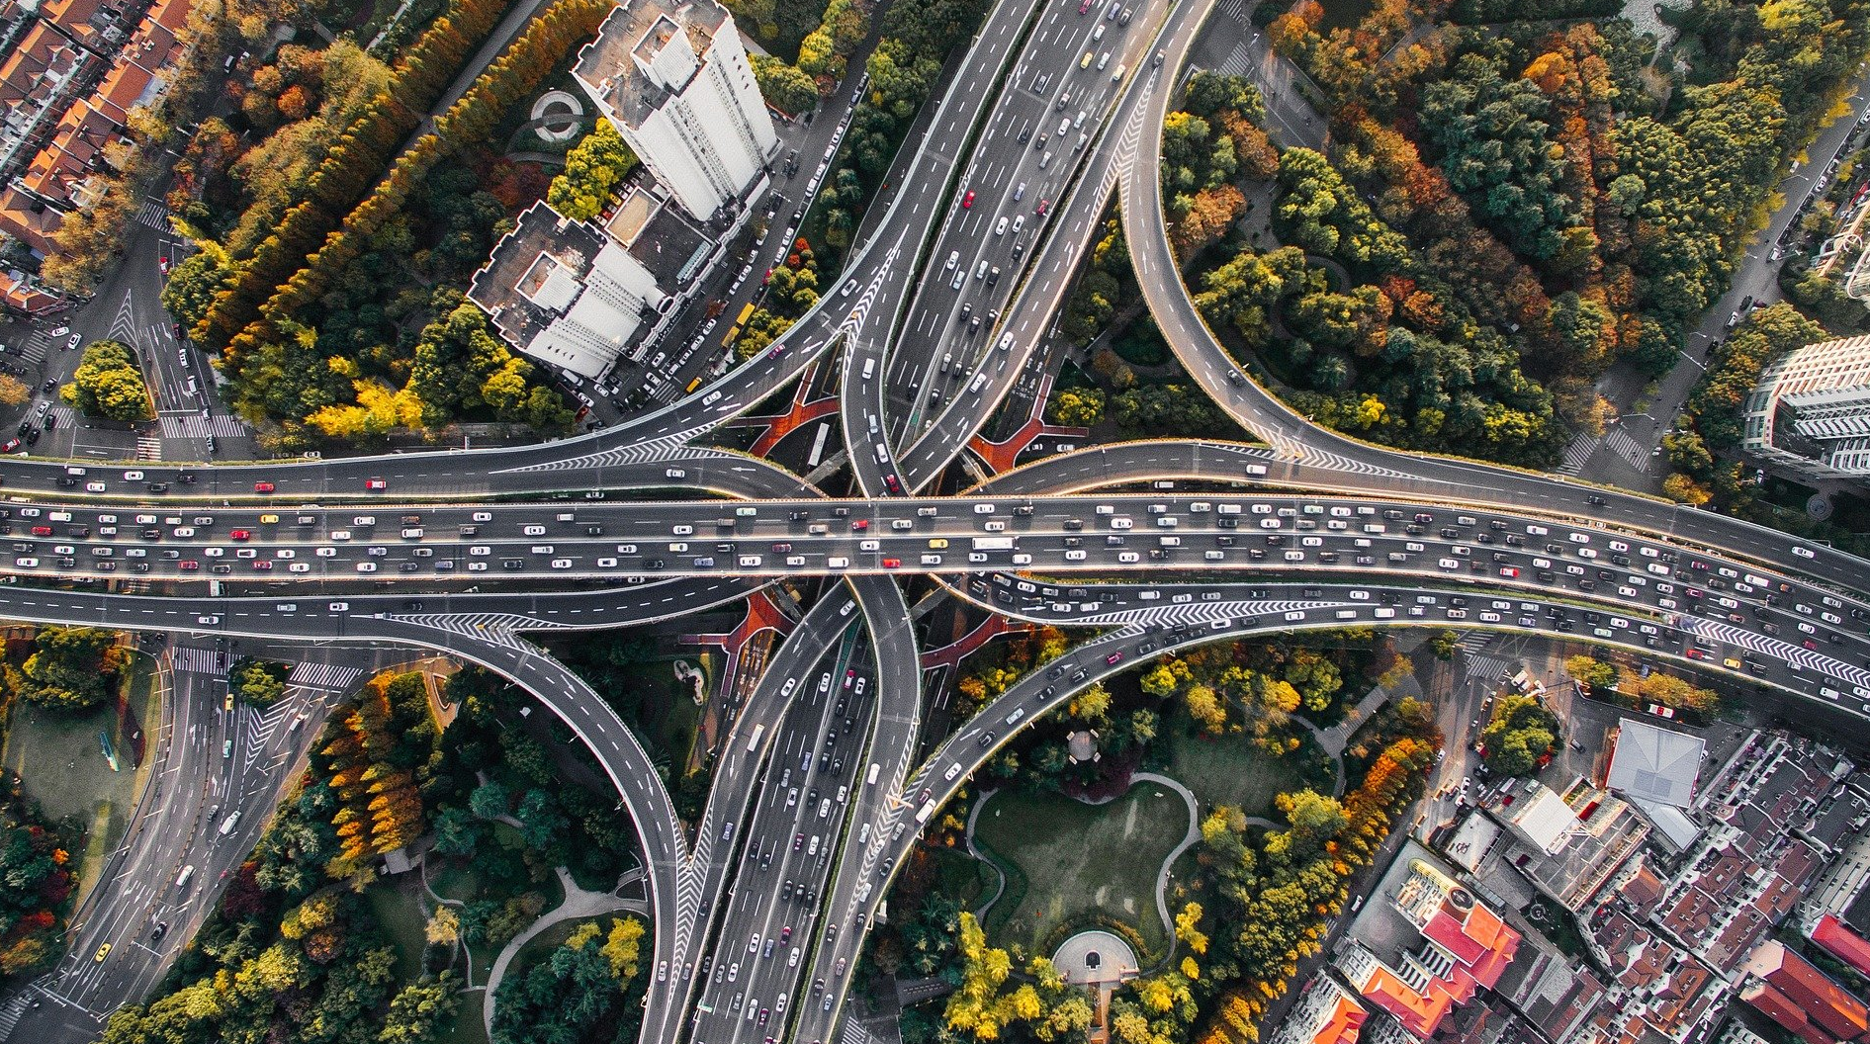
METRO INTERSTATE TRAFFIC VOLUME
I-94

Slide 2

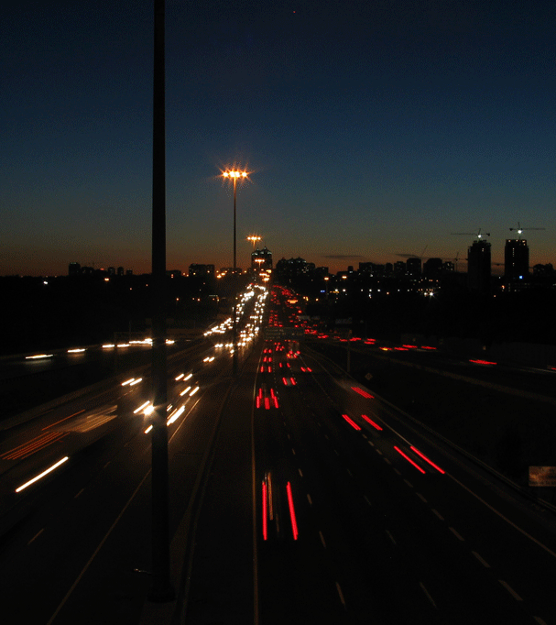

agenda
About​
Dataset Characteristics​
What comes​
Workflow
Machine Learning Models
Observations​
Outcomes​

Slide 3
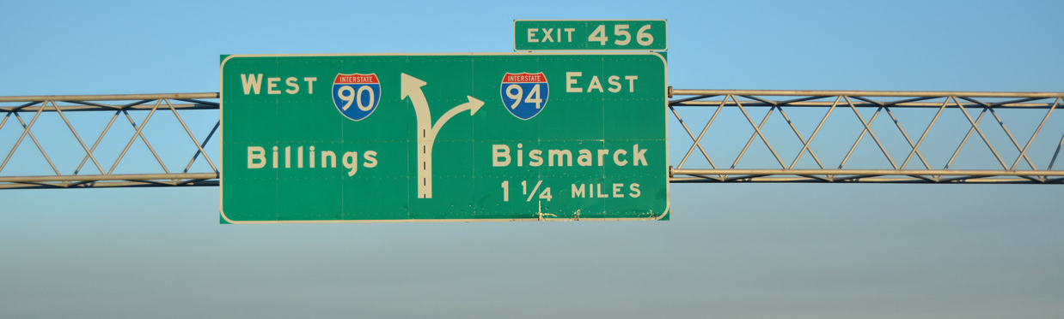
ABOUT I-94 HIGHWAY
It is an east–west Interstate Highway connecting the Great Lakes and northern Great Plains regions of the United States. It is the only east–west Interstate highway to have a direct connection to Canada.​Major cities that I-94 connects to are Minneapolis–Saint Paul, Madison, Milwaukee, Chicago, and Detroit.
This dataset consists of traffic volume between Minneapolis and Saint Paul from 2012-2018.

Slide 4
Dataset Characteristics
No. of attributes: 10
No. of Instances: 48121
DateTime - Hour of the data collected in local CST time
Junction - The number of the junction on the highway
holiday - US National holidays plus regional holiday
temp - Numeric Average temprature in kelvin
rain_1h - Numeric Amount in mm of rain that occurred in the hour
snow_1h - Numeric Amount in mm of snow that occurred in the hour
clouds_all - Numeric Percentage of cloud cover
weather_main - Categorical Short textual description of the current weather
weather_description - Categorical Longer textual description of the current weather
traffic_volume - Numeric Hourly I-94 ATR 301 reported westbound traffic volume

Slide 5

WHAT COMES?

Slide 6
What comes
To increase road safety
Maintenance of the highway​
Surge in fare prices

Slide 7
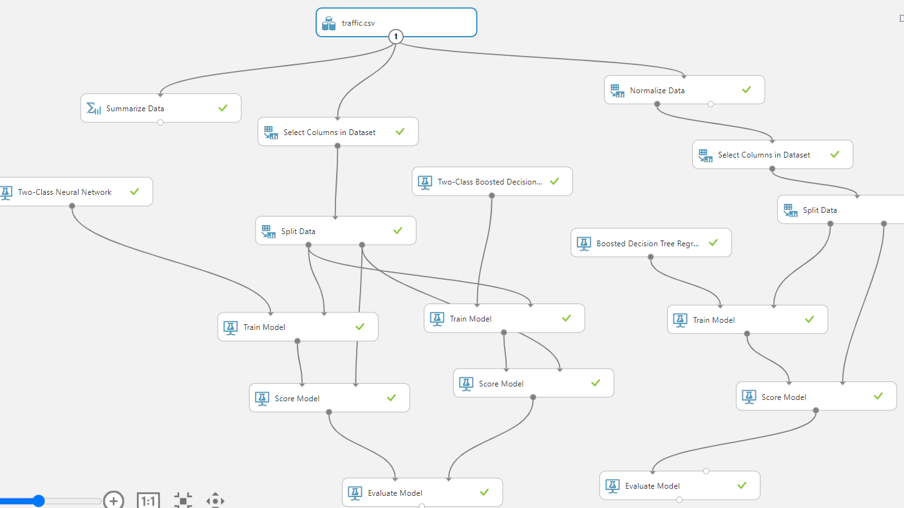
WORKFLOW
Azure ML studio has been used to train the data models.
3 different machine learning models have been used in creating the models.
Two-Class neural network
Two-Class Boosted Decision Tree
Boosted Decision Tree Regression

Slide 8
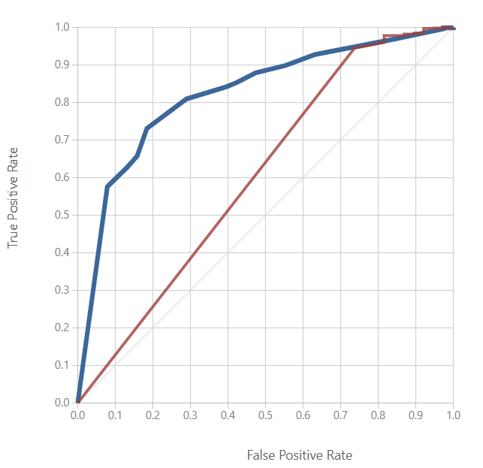
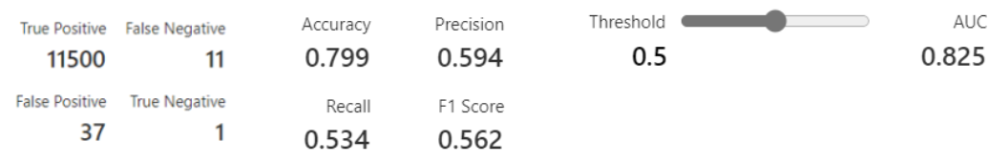
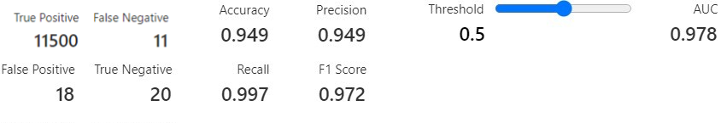
Machine learning models
Two-class neural network
Two-class boosted decision tree

Slide 9
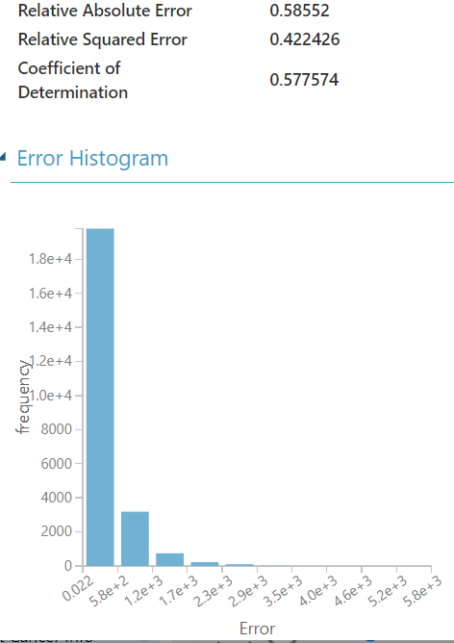
Machine learning models
Boosted decision tree regression
The regression model used here only taken numeric Independent Variables.
Coefficient of determination, represents the predictive power of the model as a value between 0 and 1. Zero means the model is random (explains nothing); 1 means there is a perfect fit .

Slide 10
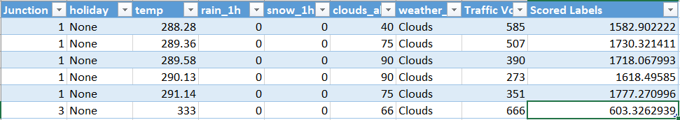
Machine learning models
Deployed model In excel
The model created from the predictive experiment is deployed into excel.
Some sample is fed into the excel sheet, which gave the predicted output

Slide 11
observations
Factors causing high traffic volumes on the I94-Interstate Highway.
Weather is the biggest contributor to high traffic volumes from 2012-2018 on the I-94 interstate highway.
Three sets of weather description appear to best correlate with high traffic volumes (>5000).
Shower Snow
Proximity thunderstorm with drizzle
Light rain and snow
Business days show higher volumes than weekend days, rush hour appears to be from (7AM-4PM).

Slide 12
outcomes
To increase road safety
Maintenance of the highway​
Surge in fare prices
Regulating the traffic to prevent accidents on the highway.
A heatmap can be generated highlighting the accident prone areas.
For the betterment of the roads.
To increase the work efficiency when repairing the roads.
Commute and travel apps like Uber and Lyft can increase the fare prices based on the traffic and weather conditions.

Slide 13

Business opportunities are like buses. There's always another one coming.​
Richard Branson

Slide 14
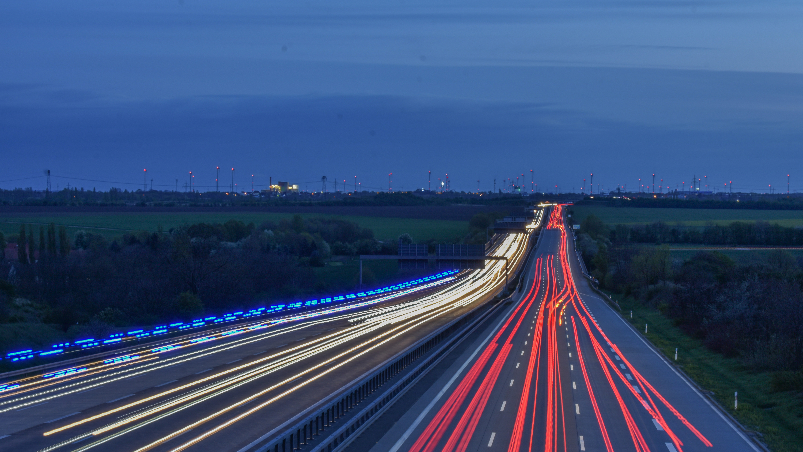
Thank you Durga Mohan Bathula – Dataset cleaning, Concept, Presentation Sai Pavan Banala – Concept, ML workflow SandhyaSree Yarra – analysis ,report Arshad Abdullah Mohammed – ml work flow, observations Abhishek Vishnubhaktula – analysis, report
Dataset downloaded from :UCI Machine Learning Repository: Metro Interstate Traffic Volume Data Set

